Slide 1
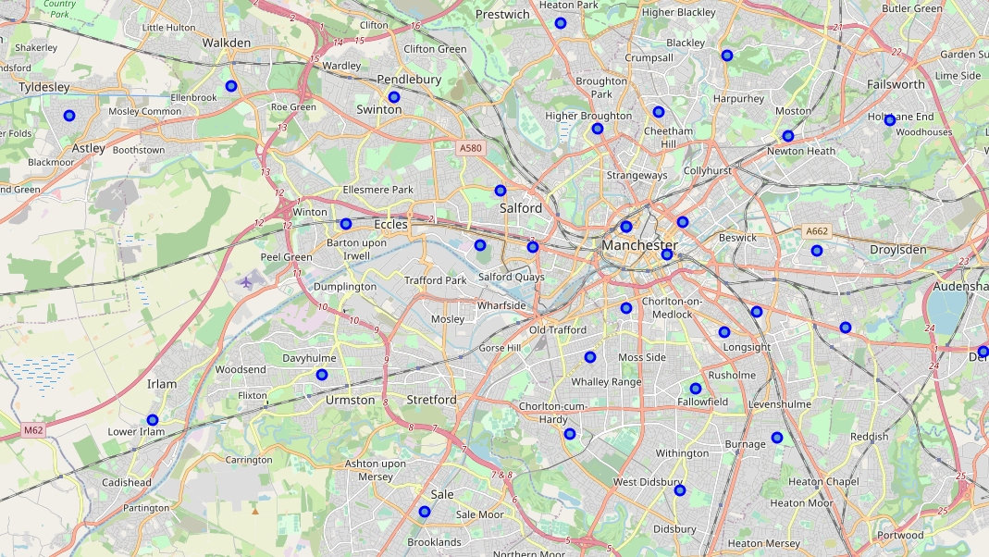
Manchester’s Most desirable suburbs, to live and invest
Amy Trueman, July 2020

Slide 2
Investing in ManchesteR, uK
The northern city of Manchester is established as the single biggest tech hub outside of London, boasting a cumulative digital turnover of around £2.9 billion and offering an impressive 62,653 digital jobs. Those jobs attract young professionals from all over the world.
Certain suburbs of Manchester have seen substantial hikes in house pricing in recent years. I believe those more affluent areas with the most expensive residential property and the highest yield for investors have larger numbers of cafes, bars, restaurants etc, so draw younger residents with high expendable income.
In this project, I will use the Foursquare API to explore suburbs of Manchester, and classify them based on popular venues. I will look at how much property costs, thus how affluent each suburb is. I will also look at the average yield in each postcode and assess whether it is related to the types of venue nearby.

Slide 3
Investing in ManchesteR, uK
The results of this project will be useful to…
Investors deciding which Manchester suburbs will give them the highest ROI on residential properties.
Young professionals looking for the most suitable and desirable areas to live in Manchester.
Councils and town planners deciding how best they can invest in Manchester suburbs and attract young professionals with high expendable income.
Holidaymakers deciding where to stay on a city break in Manchester.

Slide 4
The Data
I obtained a list of the Manchester postcodes and corresponding suburbs from the following Wikipedia page: https://en.wikipedia.org/wiki/M_postcode_area
I have downloaded data from https://propertydata.co.uk/cities/Manchester which gives the average house price, average percentage yield, increase/decrease in average house price over the last 5 years and the average rent £/sq ft, correct on 29/07/2020.
I retrieved the latitude and longitude for the out codes of Manchester postcodes (i.e. M1, M2, M3) from the following website: https://www.freemaptools.com/download-uk-postcode-lat-lng.htm
I used the Foursquare API to retrieve a list of venues in Manchester, which I categorised before analysing https://api.foursquare.com/v2/venues/explore

Slide 5
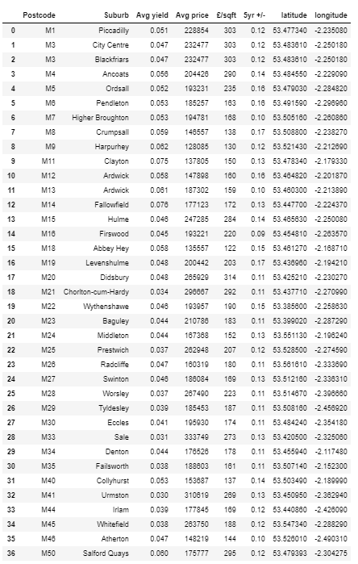
Postcode Data
The dataframe on this slide includes a list of Manchester postcodes, along with…
The Corresponding Suburb
Average Percentage Yield
Average Residential Property Price
Average £ per square foot for Residential Property
Increase/Decrease in Average Price of Residential Property in the Last 5 Years
Geographical Co-ordinates of the Central Point of the postcode.
The full dataframe is available on GitHub (df_Manchester).
This data was correct on 29/07/2020.

Slide 6
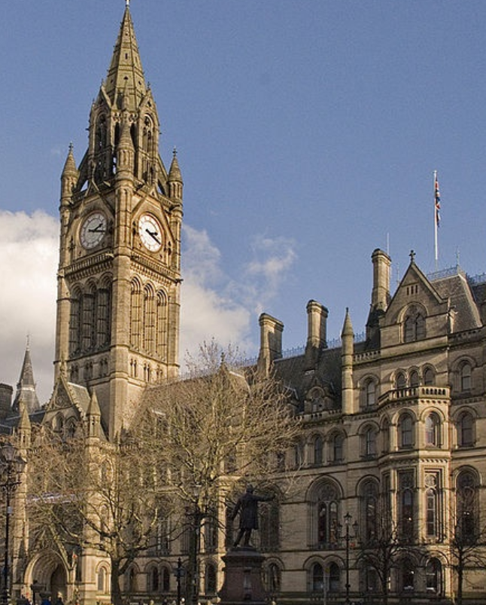
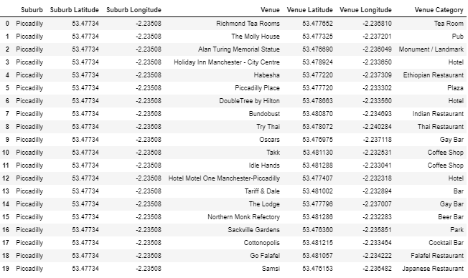
Venue data
The below dataframe includes all venues within 800m of all of each Manchester postcode, as well as the ‘venue category’ of each venue which I have obtained using the Foursquare API.
The full dataframe is available on GitHub (Manchester_venues).

Slide 7
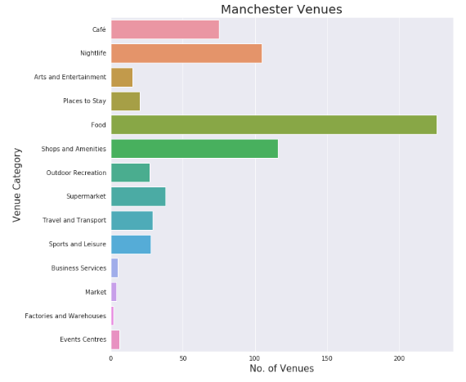
Initially, the venues were assigned categories that were slightly too specific to gather any meaningful insights, so I grouped them as follows:
VENUE DATA
Nightlife
Food
Café
Outdoor Recreation
Market
Sports and Leisure
Events Centres
Factories and Warehouses
Business Services
Travel & Transport
Arts and Entertainment
Places to Stay
Shops and Amenities
Supermarkets

Slide 8
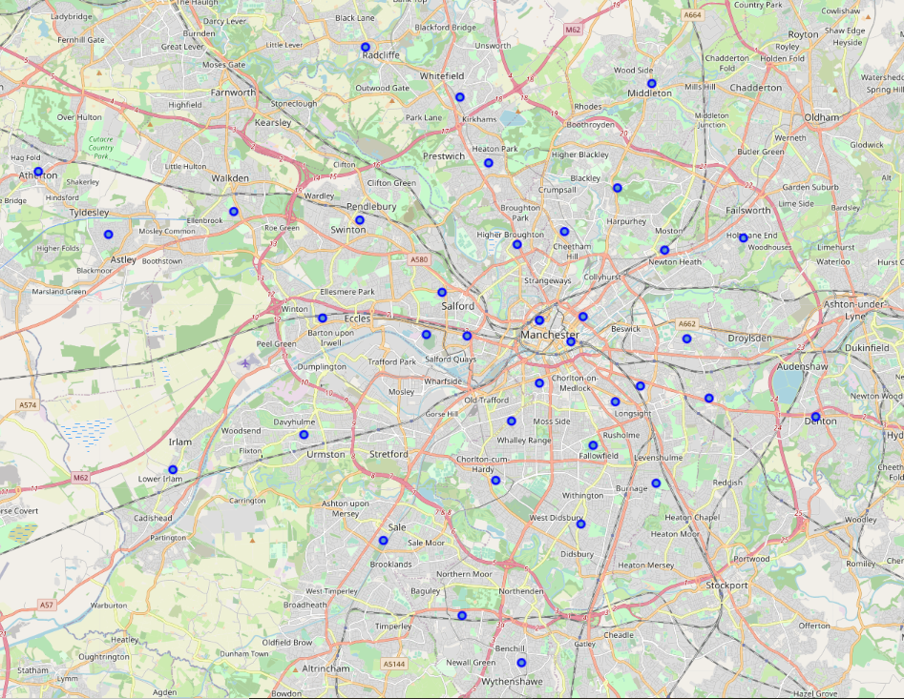
Manchester Suburbs Map
I have used Folium to plot a map of Manchester (left). The central points of all postcodes are indicated on the map with a blue circle.
Central areas include Piccadilly, Blackfriars, City Centre and Ancoats.

Slide 9
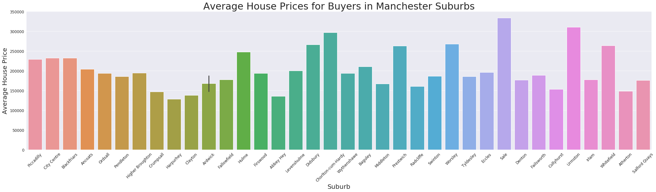
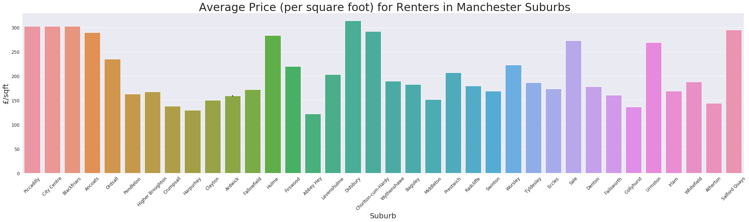
Exploratory analysis – Property Prices
These two graphs show the average house price and average rent in each of the Manchester suburbs.
The two graphs look quite similar, but notice that house prices are highest in the following areas: Didsbury, Chorlton-cum-Hardy, Prestwich, Worsley, Sale and Urmston.
We see the highest rent in the following areas: Piccadilly, City Centre, Blackfriars, Ancoats, Hulme, Didsbury, Chorlton-cum-Hardy, Sale, Urmston and Salford Quays.

Slide 10
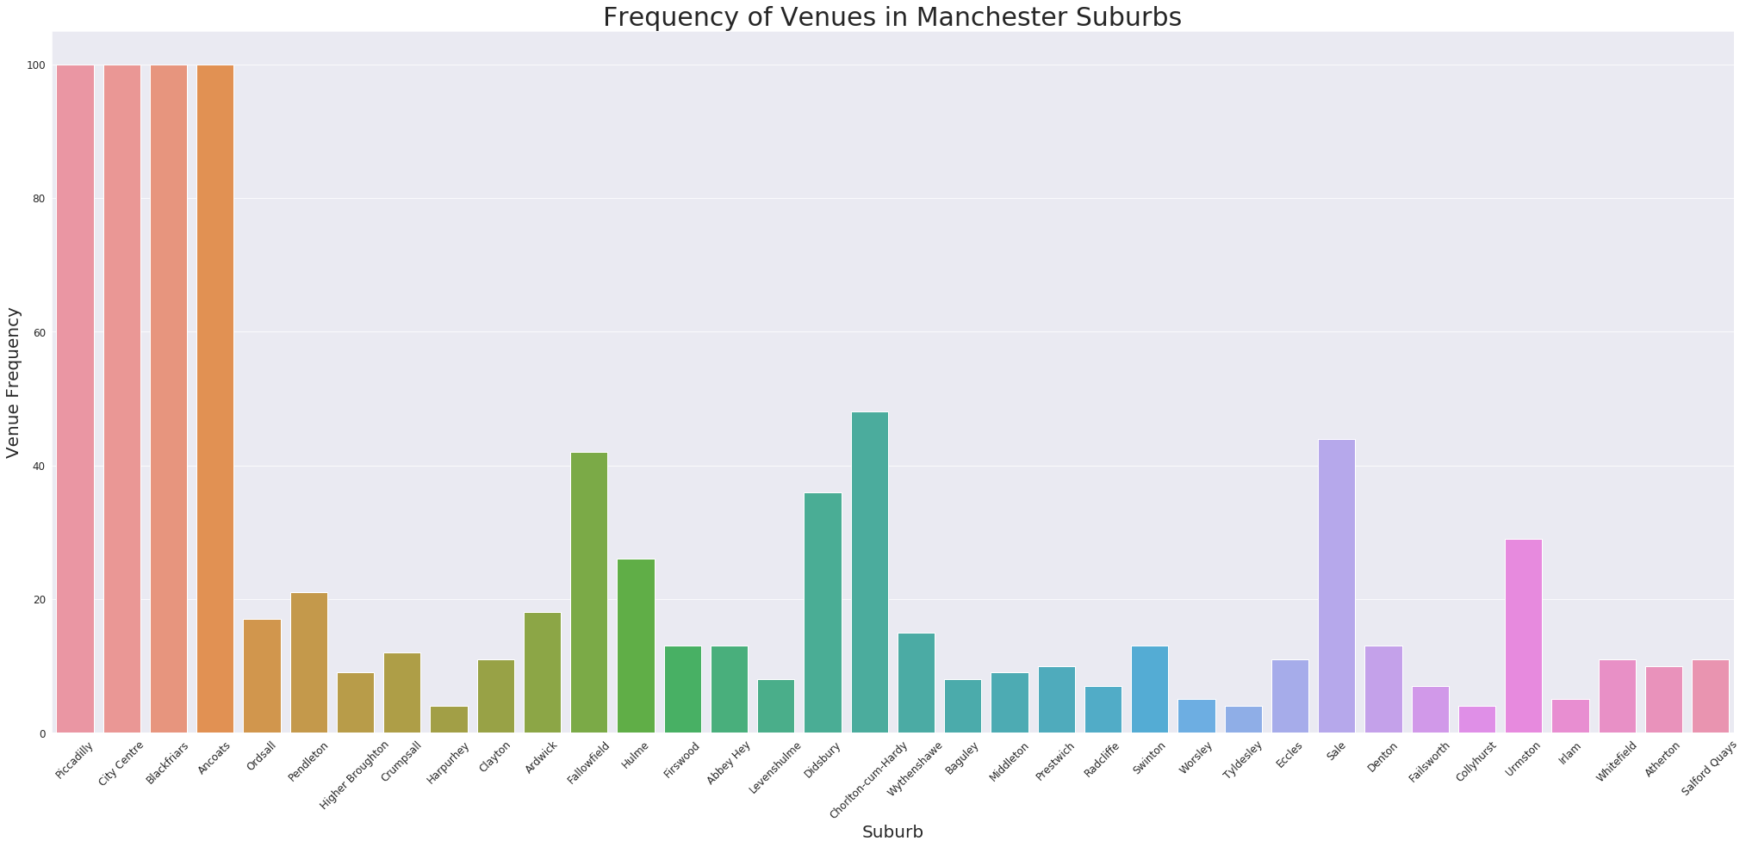
Exploratory analysis – Venue distribution
Piccadilly, City Centre, Blackfriars and Ancoats are all very central and unsurprisingly have the highest number of venues within an 800m radius. Notice they all appear in the areas with highest rent, but not highest average property prices.
Other suburbs which are further from the centre of Manchester but still have a high number of venues include Fallowfield, Didsbury, Chorlton-cum-Hardy, Sale and Urmston. With the exception of Fallowfield, these areas all feature in the areas with the highest rent and the areas with the highest house prices.
Areas with lots of venues seem to have higher rent and higher property prices with the exceptions of:
Student areas (e.g. Fallowfield) which have lots of venues but cheap housing and cheap rent.
Very central areas which have lots of venues and high rent but comparatively low average house prices as most residential properties are one-two bedroom flats as opposed to large houses.

Slide 11
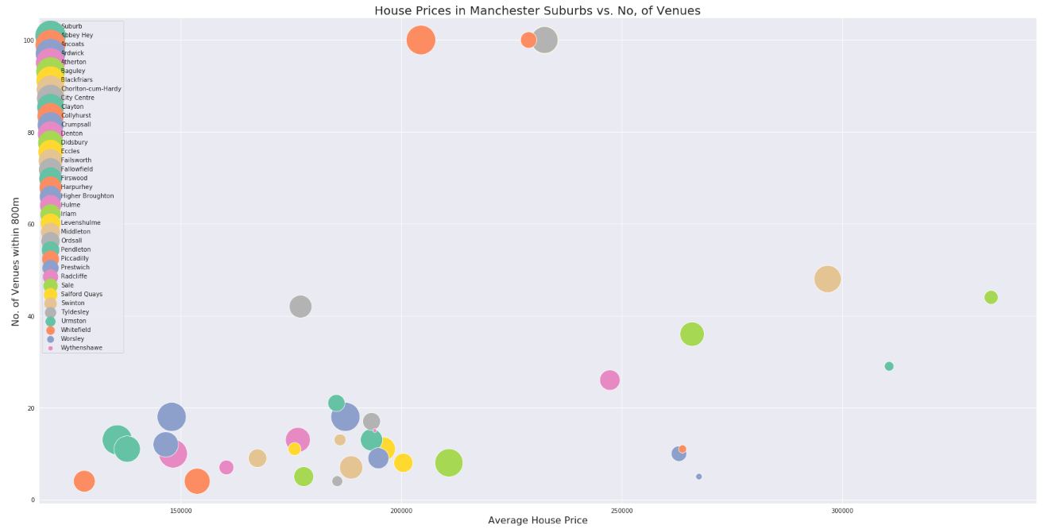
Initial insights - HOUSE PRICES are higher in
suburbs with more venues
I explored the hypothesis that there was a relationship between number of venues and rent/house prices in Manchester suburbs. From this graph, we can see that there does in fact seem to be a positive correlation between the number of venues in an area and the average price of a residential property. The relationship appears linear with some obvious outliers.
The three outliers at the top are Ancoats, Piccadilly and City Centre - all very central suburbs which obviously have a high number of venues, but where the vast majority of residential properties are one-two bedroom flats, hence the ‘low’ average house price.

Slide 12
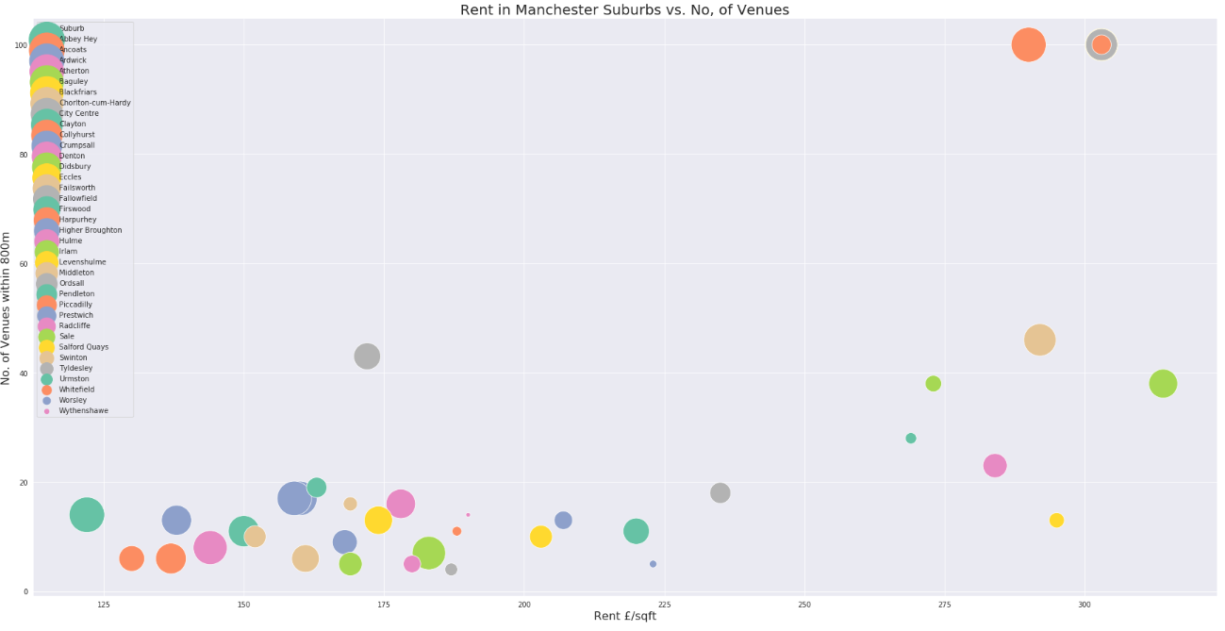
Initial insights - Rent is higher in suburbs with more venues
I explored the hypothesis that there was a relationship between number of venues and rent/house prices in Manchester suburbs. From this graph, we can see that there does in fact seem to be a strong, positive correlation between the number of venues in the area and the average price of rent(£/sqft). The relationship appears non-linear.
Fallowfield has low rent and a high number of venues nearby. This makes sense as Fallowfield is the most popular student area in Manchester.
Central areas such as the City Centre and Piccadilly have high rent (£/sqft), but a very high number of venues compared to other areas. Ancoats is less central, also has a high number of venues and high (but slightly lower) rent.

Slide 13
Statistical Analysis
From our exploratory analysis it does seem that there is a relationship between the number of venues and the price of houses, and a relationship between the number of venues in an area and the average cost of rent.
I will now explore this idea further, and see if the type of venues in an area can impact the price of property, as well as the frequency.
My hypothesis is that venues that appeal to young professionals such as nightlife, bar, eateries and cafes increase the value of property in an area.

Slide 14
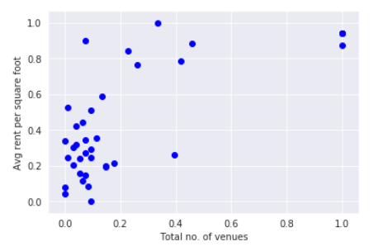
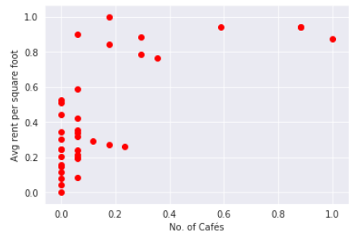
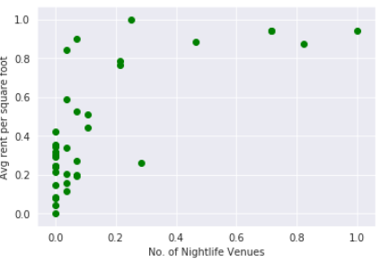
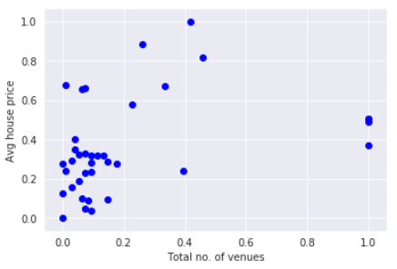
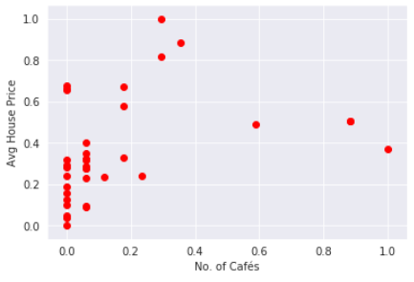
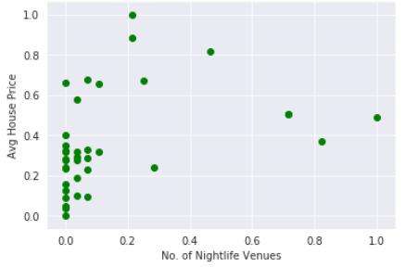
There is a Strong relationship between the no. of cafes, bars, nightlife, eateries in an area and the price of property
The correlation between total no. of venues and rent (£/sqft) is 0.708. This is a strong positive correlation.
The correlation between total no. of venues and house prices is 0.365. This is a positive correlation.
The correlation between no. of cafes and rent (£/sqft) is 0.692. This is a strong positive correlation.
The correlation between no. of cafes and house prices is 0.360. This is a positive correlation.
The correlation between no. of nightlife venues and rent (£/sqft) is 0.709. This is a strong positive correlation.
The correlation between no. of nightlife venues and house prices is 0.372. This is a positive correlation.

Slide 15
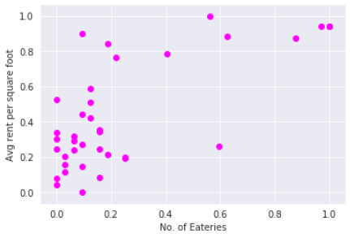
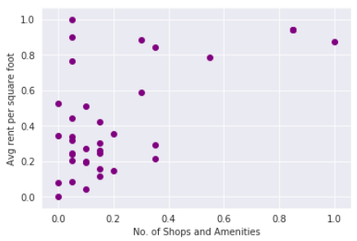
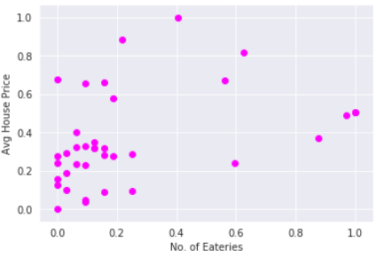
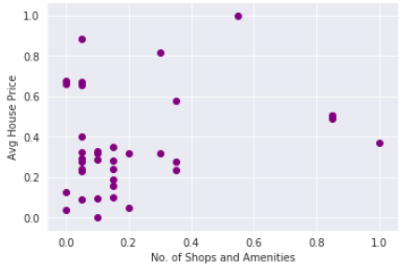
There is a relationship between the no. of cafes, bars, nightlife, eateries in an area and the price of renting/buying property
Confident that there is a relationship between the number and types of venues in areas and the price of both renting and buying property, I can now split the suburbs of Manchester into clusters based on the make-up of their venues.
The correlation between no. of eateries and rent (£/sqft) is 0.704. This is a strong positive correlation.
The correlation between no. of eateries and house prices is 0.388. This is a positive correlation.
The correlation between no. of shops/amenities and rent (£/sqft) is 0.650. This is a positive correlation.
The correlation between total no. of venues and house prices is 0.251. This is a positive correlation.

Slide 16
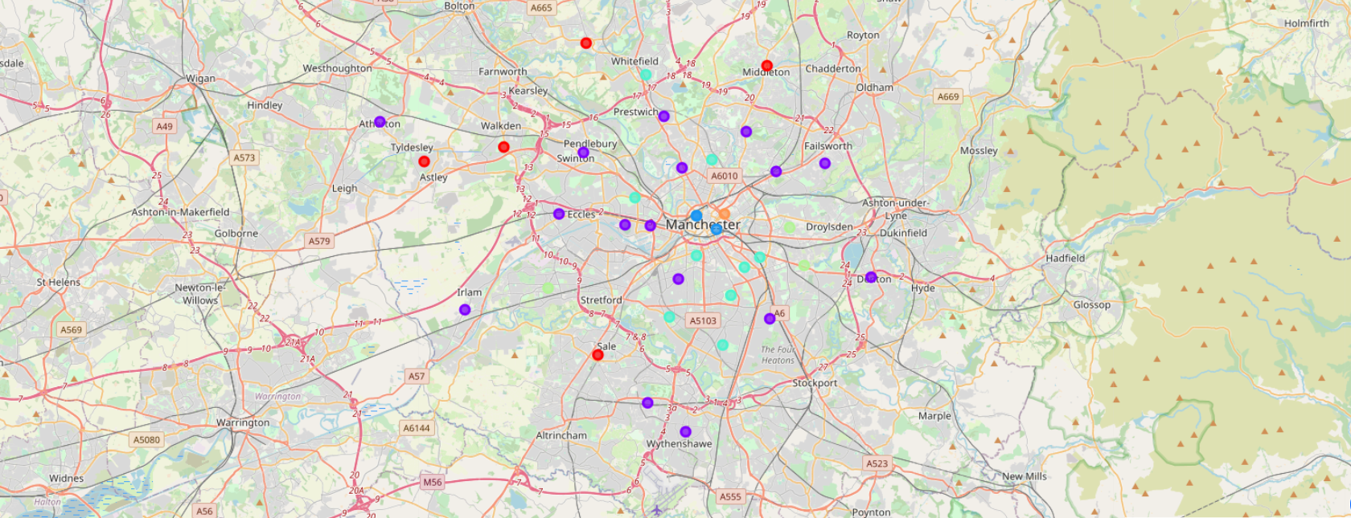
Clustering
Confident that there was a relationship between the number and types of venues in areas and the price of both renting and buying property, I split the suburbs of Manchester into 6 clusters based on the make-up of their venues.
The clusters are plotted on the map below:

Slide 17
Results – Desirable areas
Medium Blue – Areas included in the darker blue cluster are central suburbs with lots of venues including food, nightlife, places to stay, shop and amenities nearby:
Orange – Areas included in the orange cluster are very close to the centre of Manchester, have a very high number of venues, but not as many hotels etc as the very centre of town. There are also some larger, industrial buildings such as factories and warehouses.
Light Blue/Cyan – Areas included in the lighter blue cluster are not central but do have a high number of venues mostly made up of food joints, cafes, nightlife and outdoor recreation facilities. I would say this category contains the most desirable areas for young professionals!
Suburb | No. of Venues | Average Rent (£/sqft) | Average House Price (£)
Blackfriars | 100 | 303 | 232,477
Piccadilly | 100 | 303 | 228,854
City Centre | 100 | 303 | 232,477
Suburb | No. of Venues | Average Rent (£/sqft) | Average House Price (£)
Ancoats | 100 | 290 | 204,426
Suburb | No. of Venues | Average Rent (£/sqft) | Average House Price (£)
Ardwick (M12) | 18 | 160 | 147898
Ardwick (M13) | 18 | 159 | 187302
Chorlton-cum-Hardy | 48 | 292 | 296667
Crumpsall | 12 | 138 | 146557
Didsbury | 36 | 314 | 265929
Fallowfield | 42 | 172 | 177123
Hulme | 26 | 284 | 247285
Pendleton | 21 | 163 | 185257
Whitefield | 11 | 188 | 263750

Slide 18
Results – less desirable areas
Lime Green - This consists of areas of Manchester which are not central, do not have many popular venues, but do have some eateries, supermarkets and transport links:
Abbey Hey, Clayton, Urmston.
Purple – The areas in this cluster are even further out of town and are very residential, less desirable, with a low number of venues nearby. Some have good transport links or decent access to supermarkets:
Atherton, Baguley, Collyhurst, Denton, Eccles, Failsworth, Firswood, Harpurhey, Higher Broughton, Irlam, Levenshulme, Ordsall, Prestwich, Salford Quays, Swinton, Wythenshawe.
Red - The red clusters represent cluster 0, which is made up of suburbs which are far out of the centre of Manchester without many venues or transport links nearby. ‘Sale’ is the glaring exception. Sale has lots of popular venues, but has been included in this cluster as it has an events centre:
Middleton, Radcliffe, Sale, Tyldesley, Worsley.

Slide 19
conclusion
During this project I clustered Manchester’s suburbs based on the number and types of venues within 800m of the central point. I gained the following useful insights:
1. Suburbs with most venues, thus the most desirable suburbs for young professionals are:
Central Suburbs: City Centre, Blackfriars, Piccadilly, Ancoats, Hulme
Outer Suburbs: Didsbury, Chorlton-cum-Hardy, Sale, Urmston and Salford Quays
2. Rent is higher in those suburbs with more venues
3. House prices are also higher in those areas with lots of venues
4. It would make sense for investors to invest in areas where the no. of venues particularly cafes, bars and nightlife is increasing
5. Based on the results of clustering, if I were an investor I would buy property in Hulme as it is central, has access to lots of venues, rent has already increased but property prices are still low compared to suburbs such as Didsbury and Chorlton-cum-Hardy and likely to rise
6. If I were a young professional looking to move to Manchester to rent, I would choose either Chorlton-cum-Hardy or Ancoats. Rent is more reasonable in these suburbs, although the number of popular venues nearby is high.
Future Directions:
I would like to collect historical venue data so that I can see how the makeup of venues has changed in each suburb over time and measure how that has impacted house prices in each suburb, so that I can build a model to predict more accurately which areas of Manchester are most likely to see an increase in property value.

